Slide 1


Department of Computer Science and Engineering
Automated Vigilance System for Clash detection in Localized Environments using MobileNetV3
SIVAGAMA SUNDARI.V (211419104255)
SOWMIYASREE.S (211419104263)
SWATI.S (211419104283)
Guide Name & Designation
Mrs. D. JENNIFER, ME (PhD)
Assistant Professor
Coordinator Name & Designation
Dr. K. VALARMATHI, ME, PhD
Professor

Slide 2
Introduction
Hearing about the violent activities that occur on a daily basis around the world is quite overwhelming.
Personal safety and social stability are seriously threatened by the violent activities.
It will be of great significance if the surveillance systems can automatically detect violent activities and give warning or alert signals.
The proposed method is a deep learning based automatic detection approach that uses Convolutional Neural Network to detect violence present in a video.
A voice call is given to the concerned authorities.

Slide 3
Objective of the Project
The objectives of an Automated Vigilance System for Clash detection in Localized Environments using MobileNetV3 are:
To automate the detection process, by automating the detection process, the system reduces the need for manual intervention, saves time, and improves the accuracy of the detection process.
To improve the accuracy and efficiency of the detection process using MobileNetV3.
To prevent clashes before it occurs.

Slide 4
Literature Survey
SL. NO | TITLE | YEAR | JOURNAL | DESCRIPTION | DISADVANTAGE
1 | CrimeNet: Neural Structured Learning using Vision Transformer for violence detection | 2023 | Neural Networks | The neural structured learning method using vision transformers to detect violence in surveillance videos. The proposed method achieved high accuracy. | The method may require significant computational resources to train the vision transformer model.
2 | Violence Detection Approach based on Cloud Data and Neutrosophic Cognitive Maps | 2023 | Journal of Cloud Computing | The violence detection approach that uses cloud data and neutrosophic cognitive maps. The proposed approach can detect violence in real-time and outperforms existing methods. | The proposed approach may require a stable and reliable cloud infrastructure to function effectively.

Slide 5
Literature Survey
SL. NO | TITLE | YEAR | JOURNAL | DESCRIPTION | DISADVANTAGE
3 | Low-Cost CNN for Automatic Violence Recognition on Embedded System | 2022 | IEEE Access | A low-cost convolutional neural network (CNN) for automatic violence recognition on an embedded system. The proposed CNN achieved high accuracy and can run in real-time on an embedded system. | The proposed CNN may have limited detection capabilities compared to more advanced methods.
4 | Real-World Video Anomaly Detection by Extracting Salient Features in Videos | 2022 | IEEE Access | A real-world video anomaly detection method that extracts salient features in videos using deep learning techniques. The proposed method achieved high accuracy and outperformed existing methods. | The method may require significant computational resources to extract salient features from large video datasets.

Slide 6
Literature Survey
SL. NO | TITLE | YEAR | JOURNAL | DESCRIPTION | DISADVANTAGE
5 | Detection of Violent Behaviour Using Neural Networks and Pose Estimation | 2022 | IEEE Access | The detection of violent behavior using neural networks and pose estimation. The proposed method achieved high accuracy and can detect violent behavior in real-time. | The proposed method may have limitations in detecting violence in complex environments where the pose estimation may not be accurate.
6 | Affect in Multimedia: Benchmarking Violent Scenes Detection | 2022 | IEEE Transactions on Affective Computing | The benchmarking framework for evaluating the performance of violence detection methods in multimedia. The proposed framework can be used to compare and improve the accuracy of existing methods. | The benchmarking framework may not account for all factors that may affect the performance of violence detection methods in real-world scenarios.

Slide 7
Problem Statement
CCTV Surveillance is used to a greater extent but still it lacks the feature of automatic violence detection.
Manual monitoring is not a feasible task and the time taken to respond to the situation is also crucial.
The aim is to develop a real time surveillance system that can recognize violence and give alert to notify the concerned authorities.

Slide 8
Proposed System
Existing Work Algorithm Proposed Work Algorithm
Step 01: Start
Step 02 Input Image
Step 03: Preprocessing
Step 04: Convolutional Layers using depth-wise separable convolutions
Step 05: Inverted Residual Blocks
Step 06: Pooling Layers
Step 07: Fully Connected Layers
Step 08: Soft-max Layer
Step 09: Output
Step 10: Stop
Step 01: Start
Step 03: Input Layer
Step 04: Depth-wise Separable Convolution
a. Depth-wise Convolution
b. Pointwise Convolution
Step 05: Inverted Residual Blocks
Step 06: Squeeze-and-Excitation (SE) Blocks
Step 07: Fully Connected Layers
Step 08: Soft-max Layer
Step 09: Training
Step 10: Output
Step 11: Stop

Slide 9
Software / Hardware used
Hardware Environment
Processor : Intel Core i5
RAM : 25 GB
Hard Disk : 50 GB and above
Software Environment
Backend : PYTHON
Frontend : TKINTER
Technology : Deep Learning
Operating System: Windows 7
Tools: Anaconda Navigator / Tensor Flow/ Spyder/ Google Collaboratory

Slide 10
Architecture / Methodology used

Slide 11
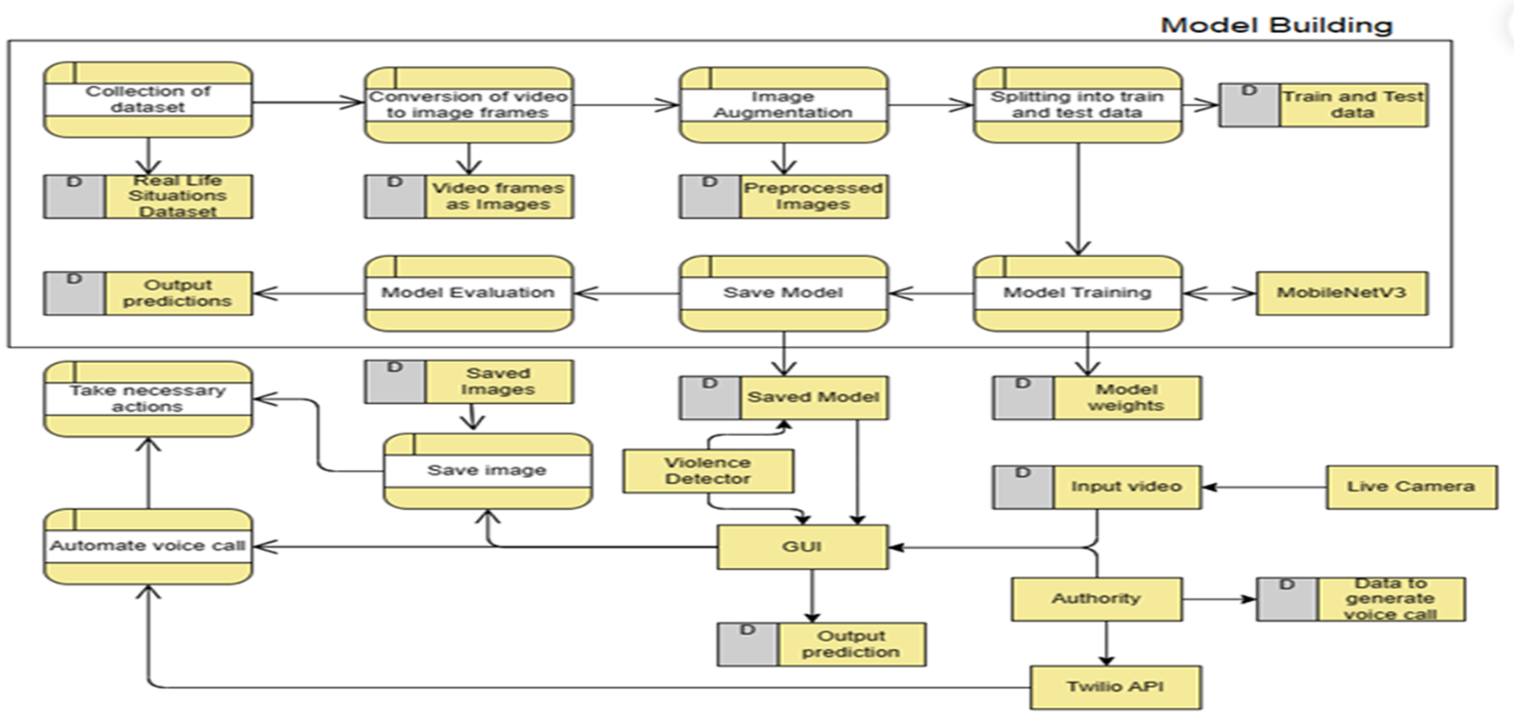
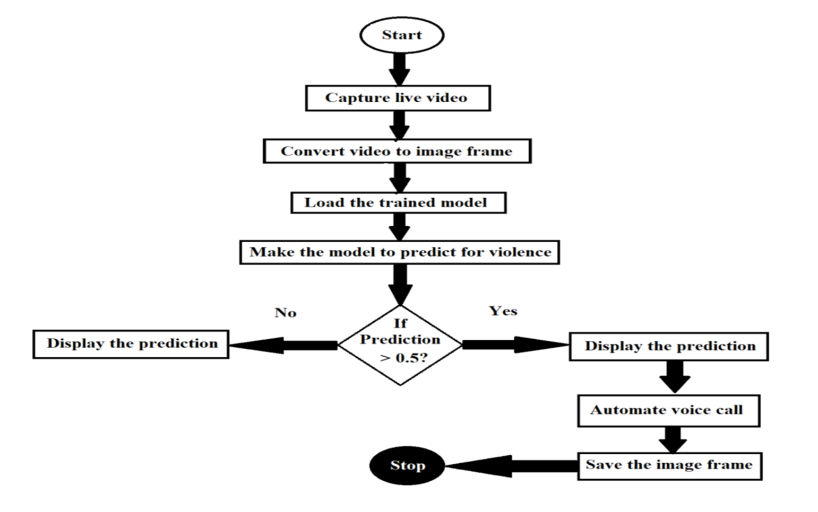
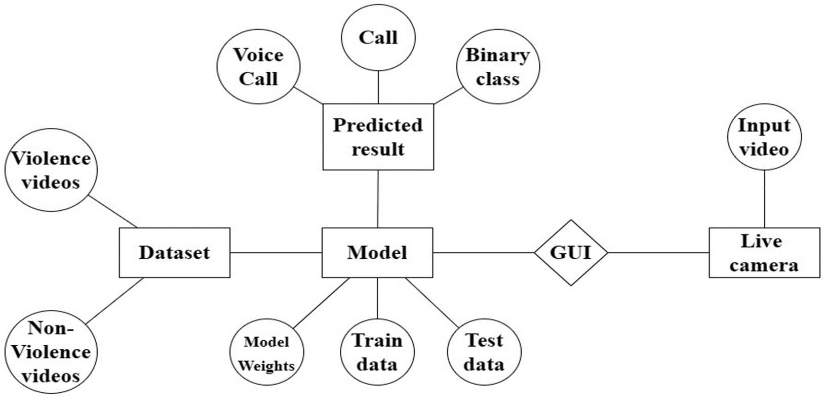
System Design - Flow Chart/DFD/ER

Slide 12
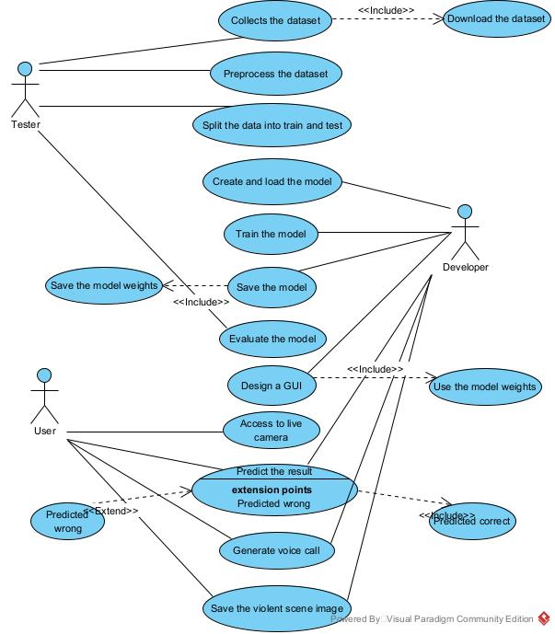
System Design – Use Case Diagram

Slide 13
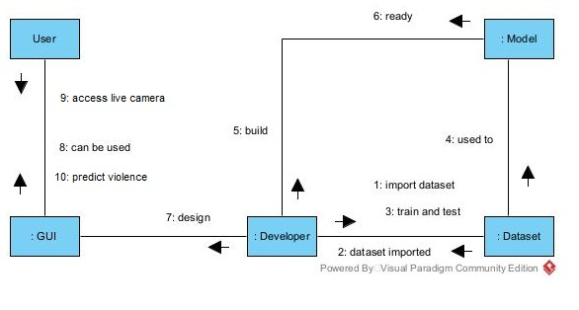
System Design – Collaboration Diagram

Slide 14
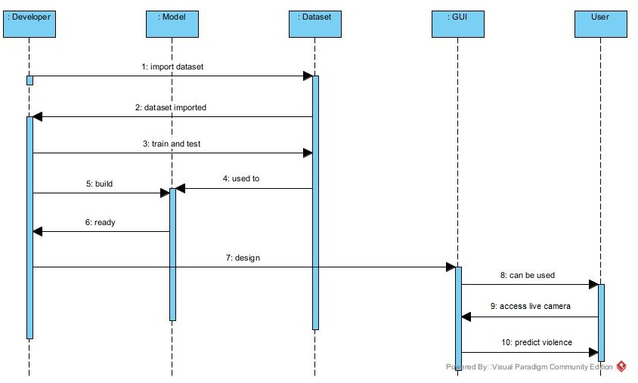
System Design – Sequence Diagram

Slide 15
Module Description
INPUT MODULE
The input module of MobileNetV3 is responsible for preparing the video dataset to images for processing by the network.
Firstly the videos are converted to image frames.
The images are then augmented.
It typically includes operations such as resizing, normalization, cropping, rotating.
These operations are essential for ensuring that the network is able to handle a wide range of input images.

Slide 16
Module Description
FEATURE EXTRACTION MODULE
The feature extraction module of MobileNetV3 is responsible for extracting high-level features from the pre-processed input image.
It consists of multiple convolutional layers that apply a series of filters to the input image to extract relevant features.
The architecture of MobileNetV3 is designed to reduce the computational cost of this module by using a combination of depth-wise separable convolutions and linear bottleneck layers.
Depth-wise separable convolutions separate the spatial and channel-wise convolutions, reducing the number of parameters and computations required.
Linear bottleneck layers further reduce the computational cost by reducing the number of channels while maintaining the quality of the feature maps.

Slide 17
Module Description
CLASSIFICATION MODULE
The classification module of MobileNetV3 is responsible for classifying the features extracted by the previous module into different categories.
In the case of violence detection, the output of this module will be a binary classification of whether the input image contains violence or not.
This module typically consists of fully connected layers that take the feature maps from the previous module and apply a series of linear transformations to produce a probability distribution over the different categories.
The final layer usually consists of a soft-max activation function to ensure that the probabilities sum to one.

Slide 18
Module Description
POST-PROCESSING MODULE
The post-processing module of MobileNetV3 is responsible for performing post-processing on the output of the classification module.
In the case of violence detection, this module may perform tasks such as thresholding the output to make a final decision on whether violence is present in the image.
The threshold is typically set based on the requirements of the application and the trade-off between false positives and false negatives.
The saved model is then used in violence detection in real time, where if violence is detected a voice call is automated and image frame is saved locally.

Slide 19
Results
The model achieved an overall accuracy of 96% with a precision of 96% for both classes, Non-Violence and Violence. The recall score was 95% for Non-Violence and 96% for Violence. The F1 score, which is the harmonic mean of precision and recall, was 95% for Non-Violence and 96% for Violence.
The high precision and recall scores suggest that the model had a low number of false positives and false negatives.

Slide 20
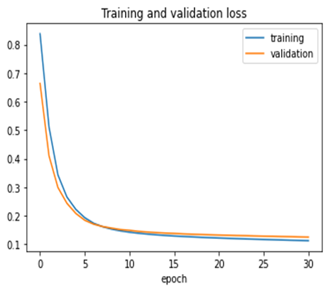
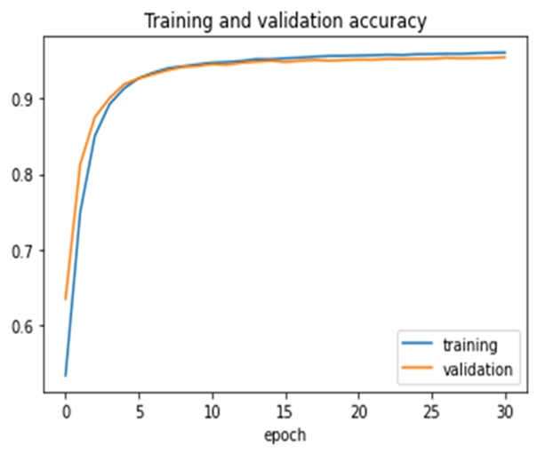
Performance Evaluation

Slide 21
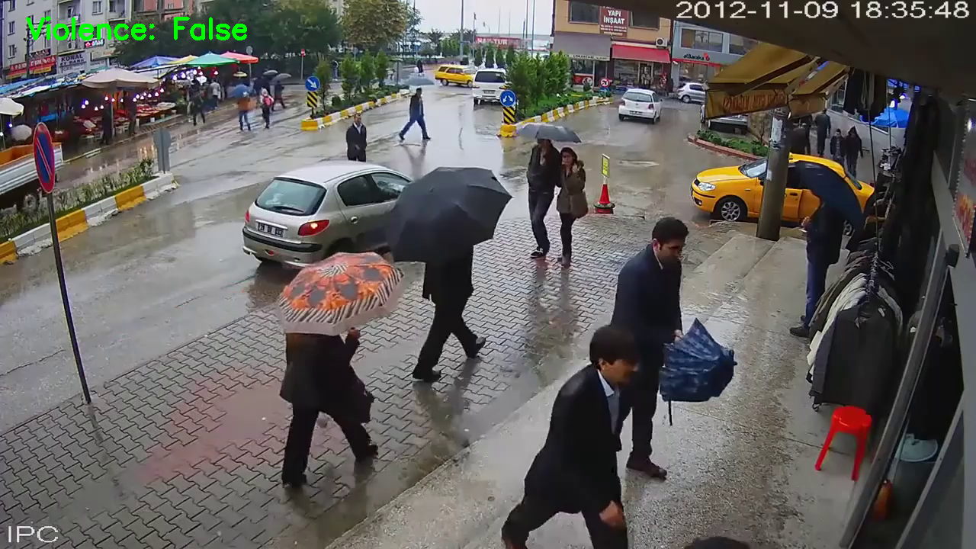
Screen Shots

Slide 22

Screen Shots

Slide 23
Conclusion / Future Enhancement
In conclusion, the proposed system provides an effective solution for detecting violence in real-time through a live camera feed.
The integration of voice call generation and image saving features can take appropriate action in case of a violent incident
Fine-tuning the model.
Additional features such as audio analysis can be incorporated.
Integration of the proposed system with surveillance cameras in public places.

Slide 24
Reference Paper
[1] F. J. Rendón-Segador, J. A. ÁlvarezGarcía, J. L. Salazar-González, and T. Tommasi, "CrimeNet: Neural Structured Learning using Vision Transformer for violence detection," Neural Networks, vol. 161, pp. 318-329, 2023, DOI: 10.1016/j.neunet.2023.01.048.
[2] M. S. Wajid, H. Terashima-Marín, P. Najafirad and M. S. Wajid, "Violence Detection Approach based on Cloud Data and Neutrosophic Cognitive Maps," Journal of Cloud Computing, vol. 12, no. 1, p. 25, 2023. DOI: 10.1186/s13677-023-00246-5.
[3] J. C. Vieira, A. Sartori, S. F. Stefenon, F. L. Perez, G. S. de Jesus and V. R. Q. Leithardt, "Low-Cost CNN for Automatic Violence Recognition on Embedded System," in IEEE Access, vol. 10, pp. 25190-25202, 2022, DOI: 10.1109/ACCESS.2022.3155123.

Slide 25
Reference Paper
[4] Y. Watanabe, M. Okabe, Y. Harada and N. Kashima, "Real-World Video Anomaly Detection by Extracting Salient Features in Videos," in IEEE Access, vol. 10, pp. 125052-125060, 2022, DOI: 10.1109/ACCESS.2022.3224952.
[5] K. B. Kwan-Loo, J. C. Ortíz-Bayliss, S. E. Conant-Pablos, H. Terashima-Marín and P. Rad, "Detection of Violent Behaviour Using Neural Networks and Pose Estimation," in IEEE Access, vol. 10, pp. 86339-86352, 2022, DOI: 10.1109/ACCESS.2022.3198985.
[6] M. G. Constantin et al., "Affect in Multimedia: Benchmarking Violent Scenes Detection," in IEEE Transactions on Affective Computing, vol. 13, no. 1, pp. 347- 366, Jan.-Mar. 2022, DOI: 10.1109/TAFFC.2020.2986969.

